Slide 1
BANK LOAN CASE STUDY
Trainity Final Project II
By
Ahamed Thanseek S

Slide 2
Project Description
A bank loan case study is given which involves 3 datasets.
1. `application_data.csv` contains all the information of the client at the time of application. The data is about whether a client has payment difficulties.
2. `previous_application.csv` contains information about the client’s previous loan data. It contains the data whether the previous application had been Approved, Cancelled, Refused or Unused offer.
3. `columns_descrption.csv` is data dictionary which describes the meaning of the variables.
We are supposed to use EDA to understand how consumer attributes and loan attributes influence the tendency of default.

Slide 3
Approach used: The `previous_application.csv` provided is extremely large csv files which are unable to be loaded into MS Excel. So I have used a csv splitter software to divide the data into 4 small files namely excel0, excel1, excel2 and excel3, each having 500000 rows except the last one. These are imported separately in different excel sheets and operations which are performed in one is replicated in the remaining.
Above mentioned process is not done for `application_data.csv` since the dataset is relatively small.
All the columns present in both the datasets are clearly read and understood from `columns_descrption.csv` in order to have a good understanding on the problems to be solved.
I have also done a decent research on several terms that were new to me.
Click here to view all the working excel sheets.
Tech Stacks used : MS Excel features and concepts of statistics are mainly used throughout the project.

Slide 4
RESULTS

Slide 5
Data Cleaning
`previous_application.csv` : There were 37 columns and 16,70,214 rows which I have split into four separate sheets.
`application_data.csv` : There are 122 columns and 3,07,511 rows.
Handling duplicates : There were no duplicates in both the datasets
Handling missing values : In previous_application, columns having higher missing values have been analysed and found that RATE_INTEREST_PRIMARY and RATE_INTEREST_PRIVILEGED has nearly 99 percent of cells as empty. So these two columns are completely deleted. We have to remove rows having empty cells at the same time we should not lose critical parts of data. So rows having all three of AMT_ANNUITY, AMT_APPLICATION, AMT_CREDIT as blank or 0 has been removed.
In application_data, no rows or columns are removed.

Slide 6
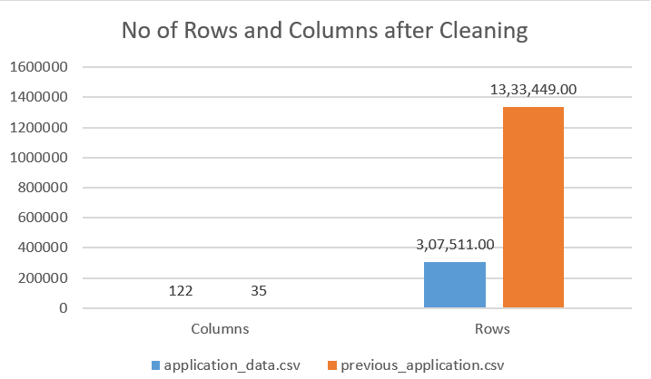
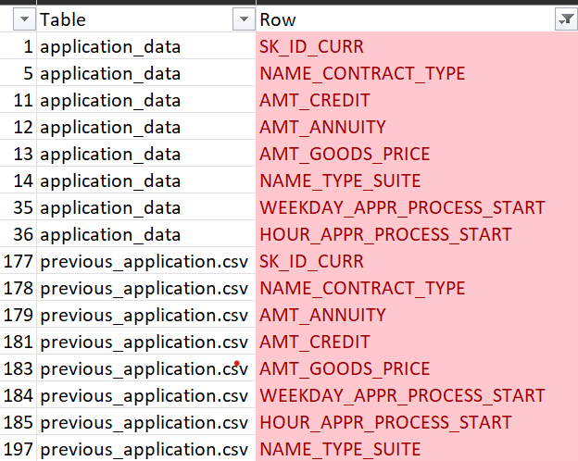
Insights:
There are 8 columns common to both csv files.
And SK_ID_CURR is the unique identifier among the
Datasets.

Slide 7
Outliers
These are observations in a dataset that significantly varies from the other observations, it can either be very high or very low and can impact the conclusions to be drawn from the dataset.
Presence of outliers are checked in both the datasets. They are represented below.
previous_application:
Column Name | Q1 | Q3 | IQR | Upper Bound | Lower Bound
AMT_ANNUITY | 6305.6475 | 20545.5375 | 14239.89 | 41905.3725 | -15054.1875
AMT_APPLICATION | 45000 | 225000 | 180000 | 495000 | -225000
AMT_CREDIT | 51898.5 | 270000 | 218101.5 | 597152.25 | -275253.75
AMT_DOWN_PAYMENT | 0 | 7726.5 | 7726.5 | 19316.25 | -11589.75
AMT_GOODS_PRICE | 50809.41 | 229500 | 178690.59 | 497535.885 | -217226.475

Slide 8
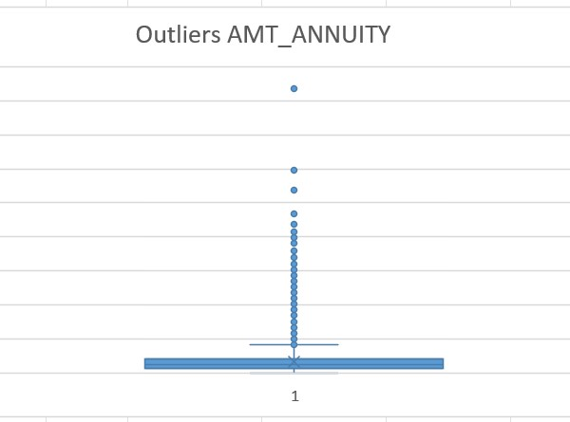
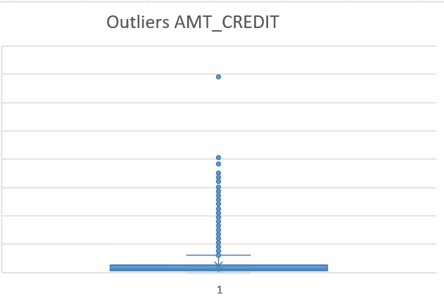
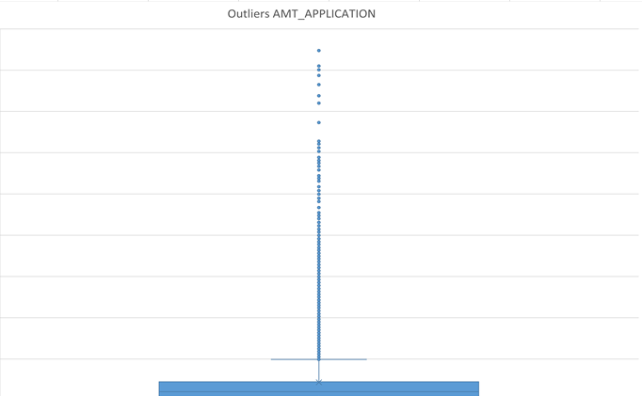
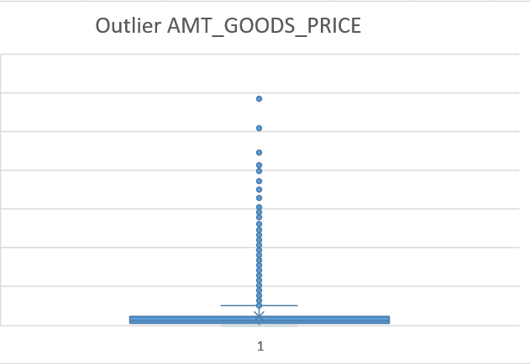
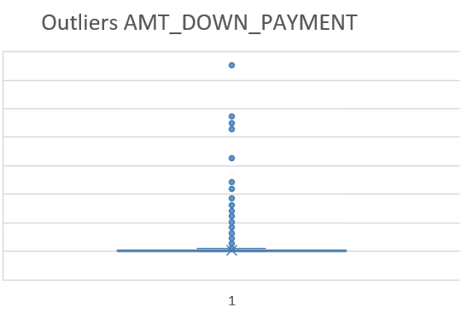

Slide 9
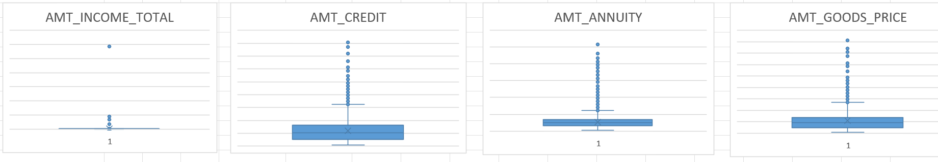
application_data:
Column Name | Q1 | Q3 | IQR | Upper Bound | Lower Bound
AMT_ANNUITY | 16524 | 34596 | 18072 | 61704 | -10584
AMT_CREDIT | 270000 | 808650 | 538650 | 1616625 | -537975
AMT_INCOME_TOTAL | 112500 | 202500 | 90000 | 337500 | -22500
AMT_GOODS_PRICE | 238500 | 679500 | 441000 | 1341000 | -423000
Insights: Outliers are present for both datasets.

Slide 10
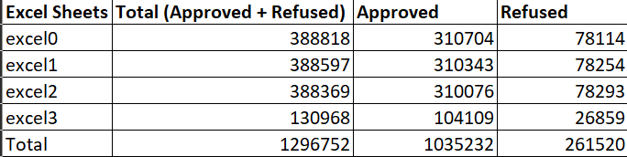
Data Imbalance
Imbalanced dataset is the one in which one or more labels make up majority of the dataset.
In previous_application, we are considering the NAME_CONTRACT_STATUS i.e. the status of previous application since it will give an idea on rejected and approved rates which helps in prediction of current applicants.
For this study cancelled and unused have not been taken into consideration.
The attached screenshot shows the count of approved and refused in previous application.
The excel sheets have been named after splitting the previous_application as mentioned in Project Approach

Slide 11

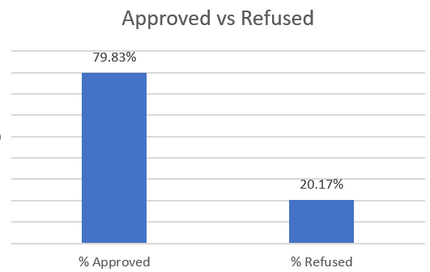
Insights: This clearly indicates that we have a strong data imbalance in applications.

Slide 12

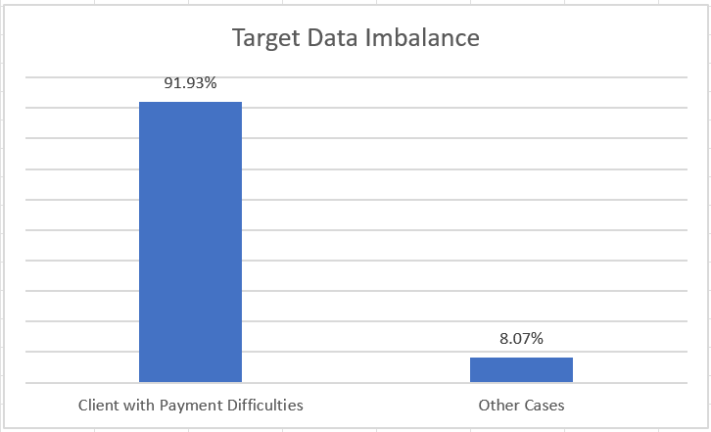
In application_data, TARGET has been taken to represent the data imbalance
Insights: This clearly indicates that we have a strong data imbalance in target.

Slide 13
Univariate Analysis
Univariate analysis is a form of analysis that only involves a single variable. Both numerical and categorical data are analyzed.
Descriptive Statistics is found for numerical data which includes mean, median, standard deviation, mode, sample variance, kurtosis, skewness, range, max, min, sum, count, largest (2), smallest (2).
Pie chart is used for representing categorical data.
Here we have considered mainly the common variables among both datasets and some other ones of relevance, which are shown in the coming slides.

Slide 14
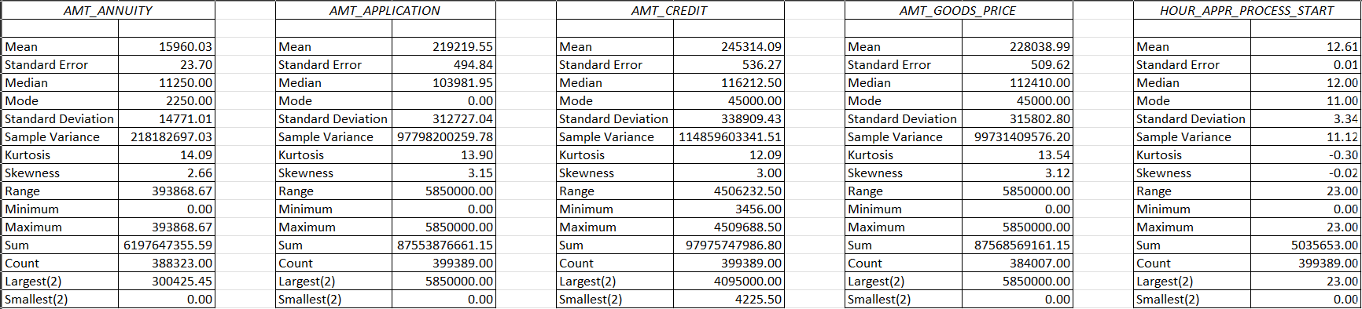
previous_application :
The above table is from one of the four files to which previous_application was split into.

Slide 15
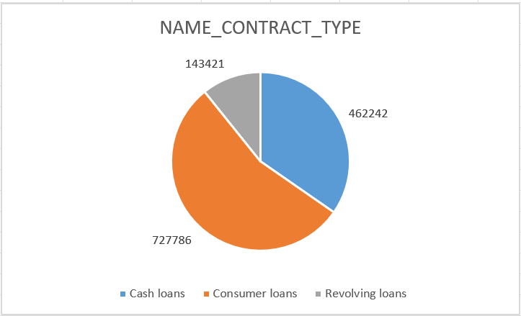
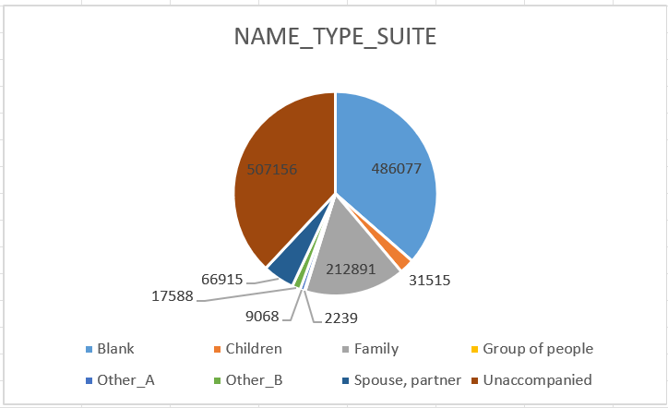

Slide 16
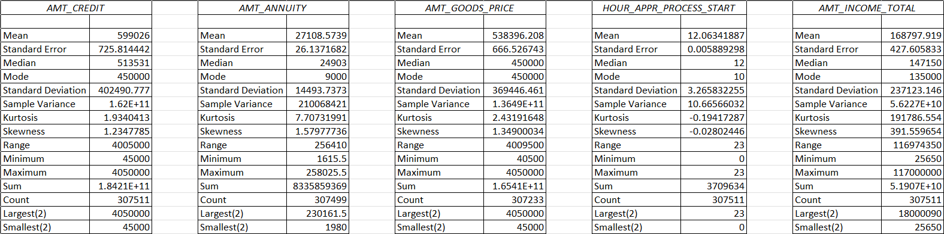
application_data:

Slide 17
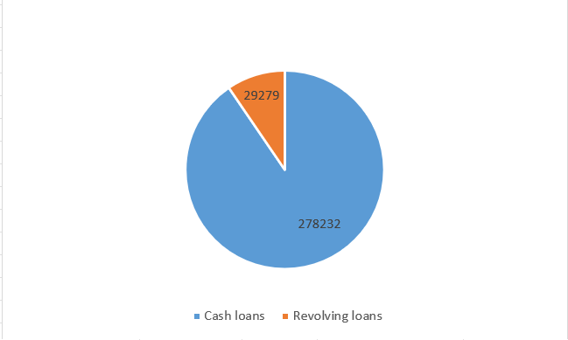
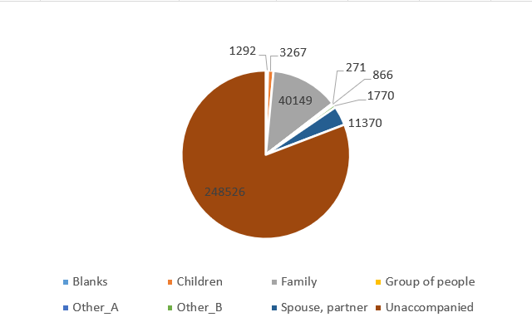
NAME_CONTRACT_TYPE
NAME_TYPE_SUITE

Slide 18
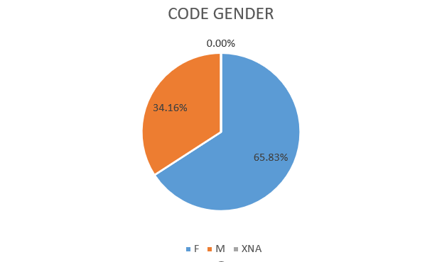
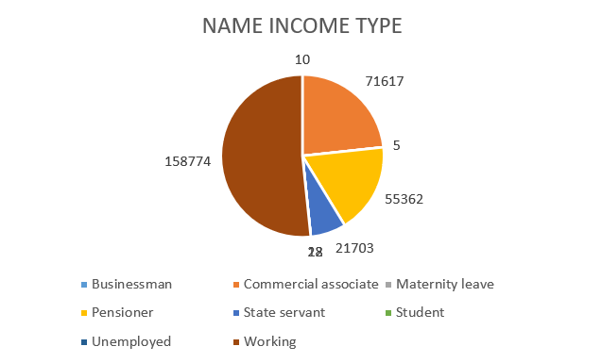

Slide 19
Insights:
We do not have any consumer loans in current application_data.
There is a huge amount of missing data in NAME_TYPE_SUITE for previous application data.
Majority of the people according to NAME_TYPE_SUITE is unaccompanied.
Males makes up majority of the applications nearly 66%.
Most of the applicants are Working class.
There is a significant increase in mean of AMT_CREDIT and AMT_GOODS_PRICE from previous application.

Slide 20
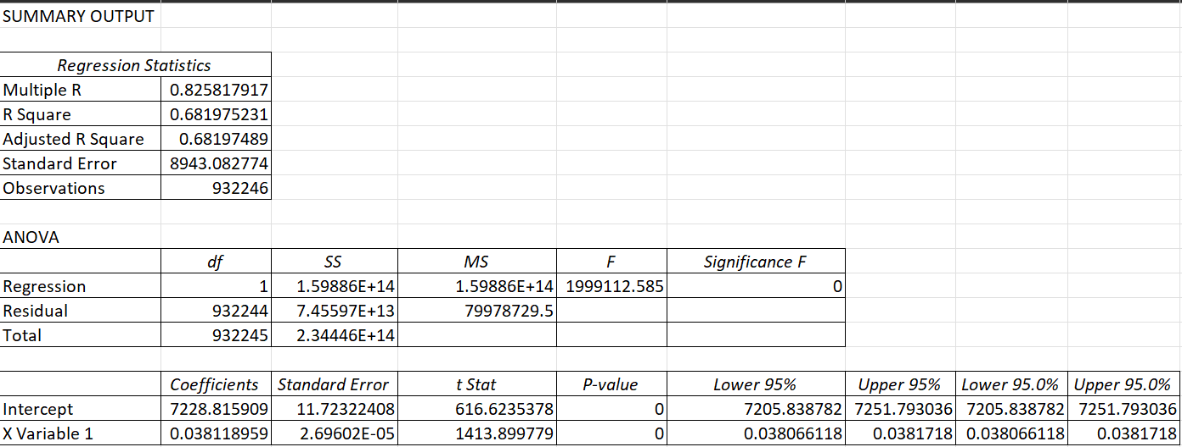
Bivariate Analysis
This involves the analysis of two variables, for the purpose of determining the empirical relationship between them. This includes statistical tools such as regression analysis, correlation analysis etc.
Regression Analysis:
Here we have considered AMT_ANNUITY vs AMT_GOODS_PRICE from previous_application as an example.

Slide 21
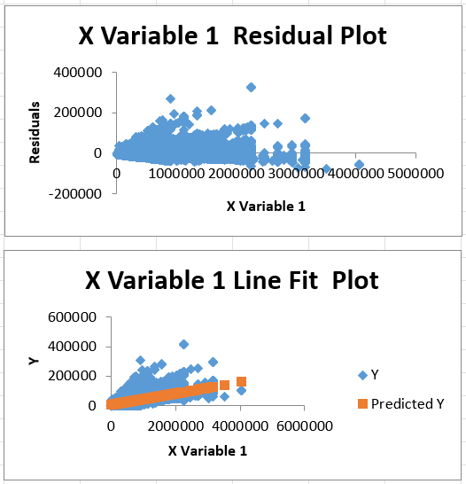
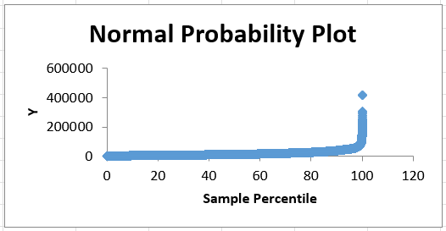
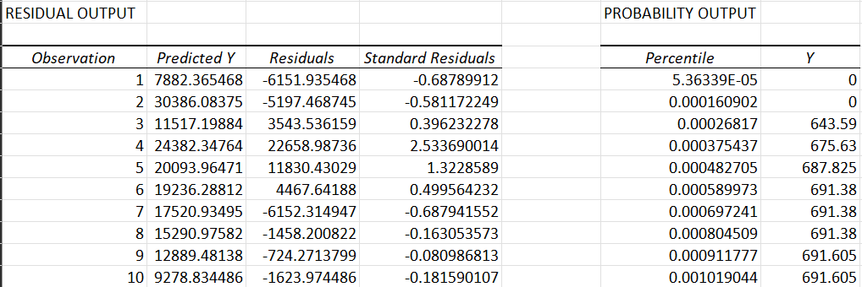

Slide 22
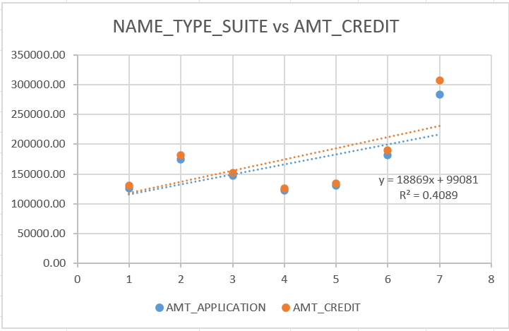
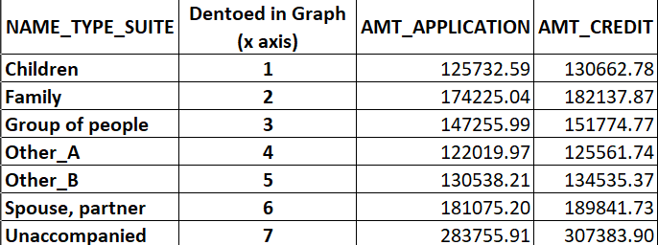
Correlation Analysis:
An example of mean AMT_APPLICATION and AMT_CREDIT for different NAME_TYPE_SUITE.
An illustration using Scatter plot is also given.

Slide 23
Correlation analysis for client with payment difficulties
The variables considered were AMT_INCOME_TOTAL, AMT_CREDIT, AMT_ANNUITY, AMT_GOODS_PRICE, REGION_POPULATION_RELATIVE, DAYS_BIRTH, DAYS_EMPLOYED, DAYS_REGISTRATION, DAYS_ID_PUBLISH, OWN_CAR_AGE, EXT_SOURCE_1, EXT_SOURCE_2, EXT_SOURCE_3, APARTMENTS_AVG, DAYS_LAST_PHONE_CHANGE.

Slide 24
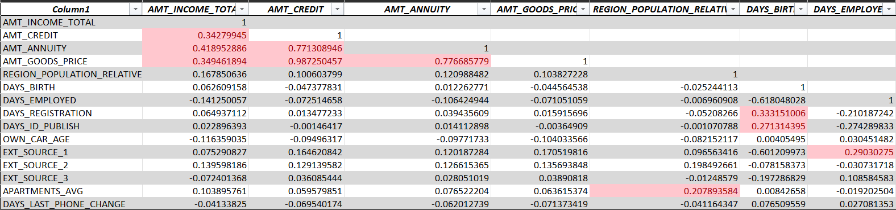
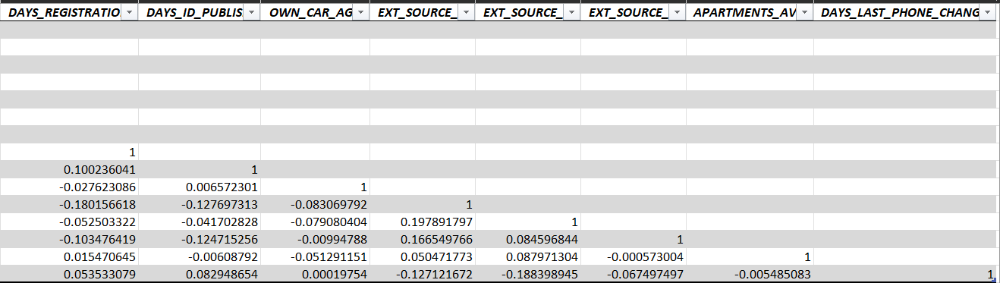

Slide 25
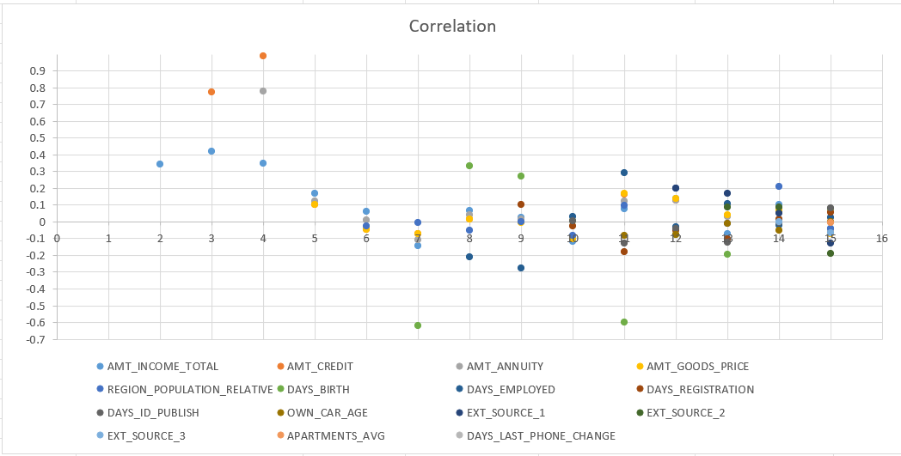

Slide 26
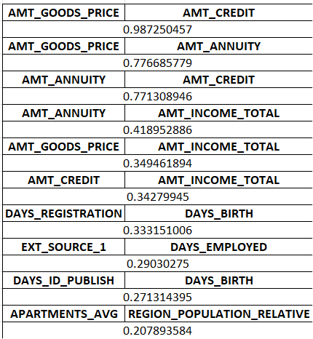
Insights:
The top 10 variables with highest correlation are given here:

Slide 27
All the working files used in this projects can be accessed on the link below.
Click here

Slide 28
THANK YOU

